Slide 1





Robert Indelicato
Data Analyst Portfolio
732.915.4785

Slide 2

About Me
My name is Robert, and I am an accomplished Data Analyst skilled in extracting actionable insights from extensive datasets using data-driven approaches to drive growth and propel the business forward.

Slide 3
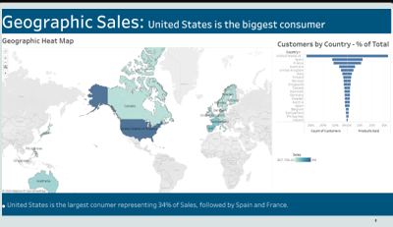
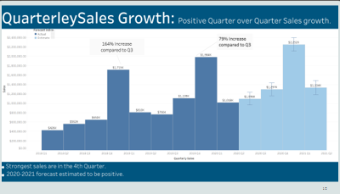
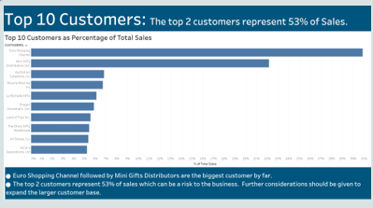
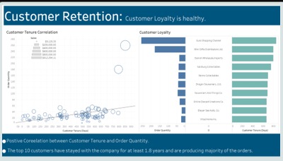
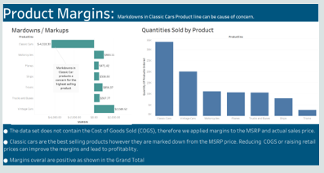
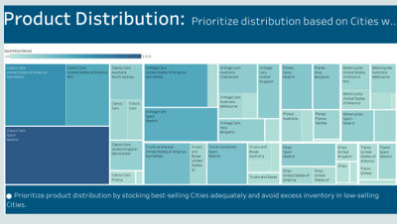
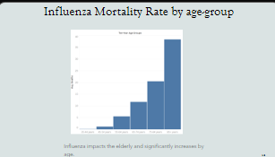
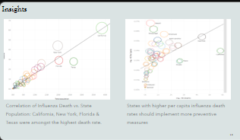
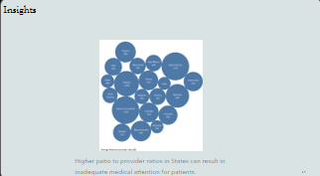
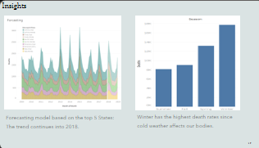
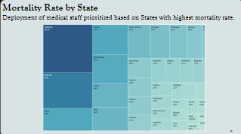
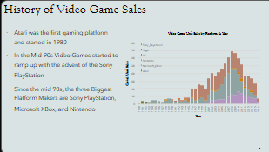
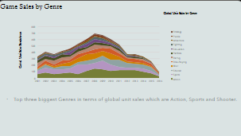
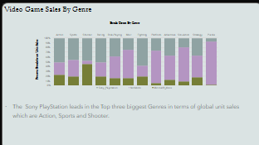
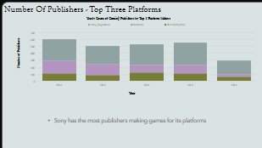
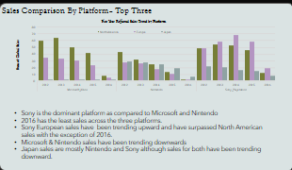
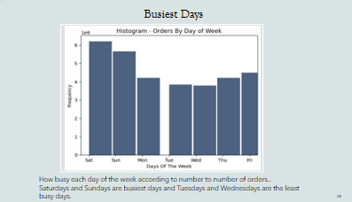
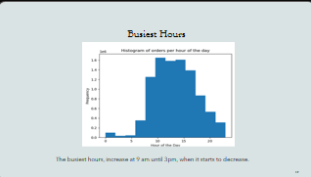
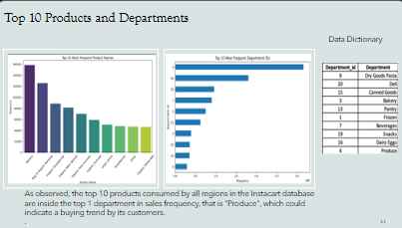
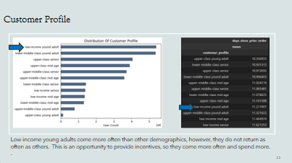
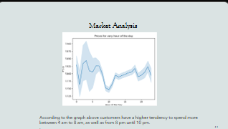
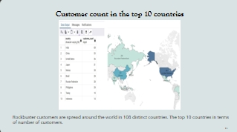
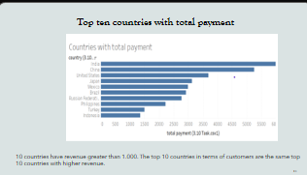
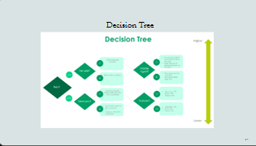
Introductory Slides – Skillset Analytics

Slide 4
Projects
Auto Toy Sales
Influenza – Forecasting
GameCo – Market Analysis
Instacart – Python Analysis
Rockbuster Stealth – SQL
Pig E. Bank – Big Data Analysis

Slide 5






Tools
Microsoft Excel
Tableau
SQL
Python
Github
Jupyter Notebook

Slide 6

Auto Toy Sales Exploratory Data Analysis of an Auto Toy Company that is selling mini collectables to customers located around the world.
Explore trends and patterns driving sales
Geographic heat map
Product distribution
Predictive analysis using forecasting
Summary and recommendations

Slide 7
Auto Toy Sales Company
Skills
Python Libraries – Pandas, Numpy,, Requests, Pylab.
Machine Learning – Sklearn: Linear Regression, Kmeans, mean_squared_error, r2_score, train_test_split
Visualization with Python – Folium, Seaborn, Matplotlib & Scipy
Jupyter Notebook
Tableau
Data
Challenges
Data format - Excel
Python Libraries - Pandas and Numpy
Data Wrangling and Subsetting
Data Consistency Check
Deriving variables, Grouping & Aggregating data
Combining, Enriching and Exporting Dataframe
Automobile Sales data – Via Kaggle
Data cleaning, missing data, format issues and standardizing the dataset.
The data has time limitation, only has five months of 2020, not full complete data set.

Slide 8
Insights
Few contributing factors on why auto toy sales are healthy
U.S. and Spain are the 2 highest Distribution countries.
Classic Cars is the only product with markdown margin, while the rest of the products have high margins.
Toys cars are highest quantity product and sales.
In Q1 of 2018 and Q1 2020 Toy sales were surprisingly high.

Slide 9
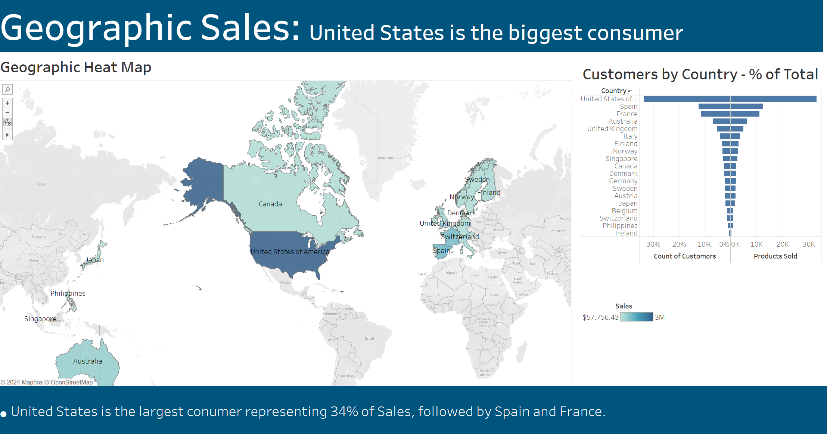

Slide 10
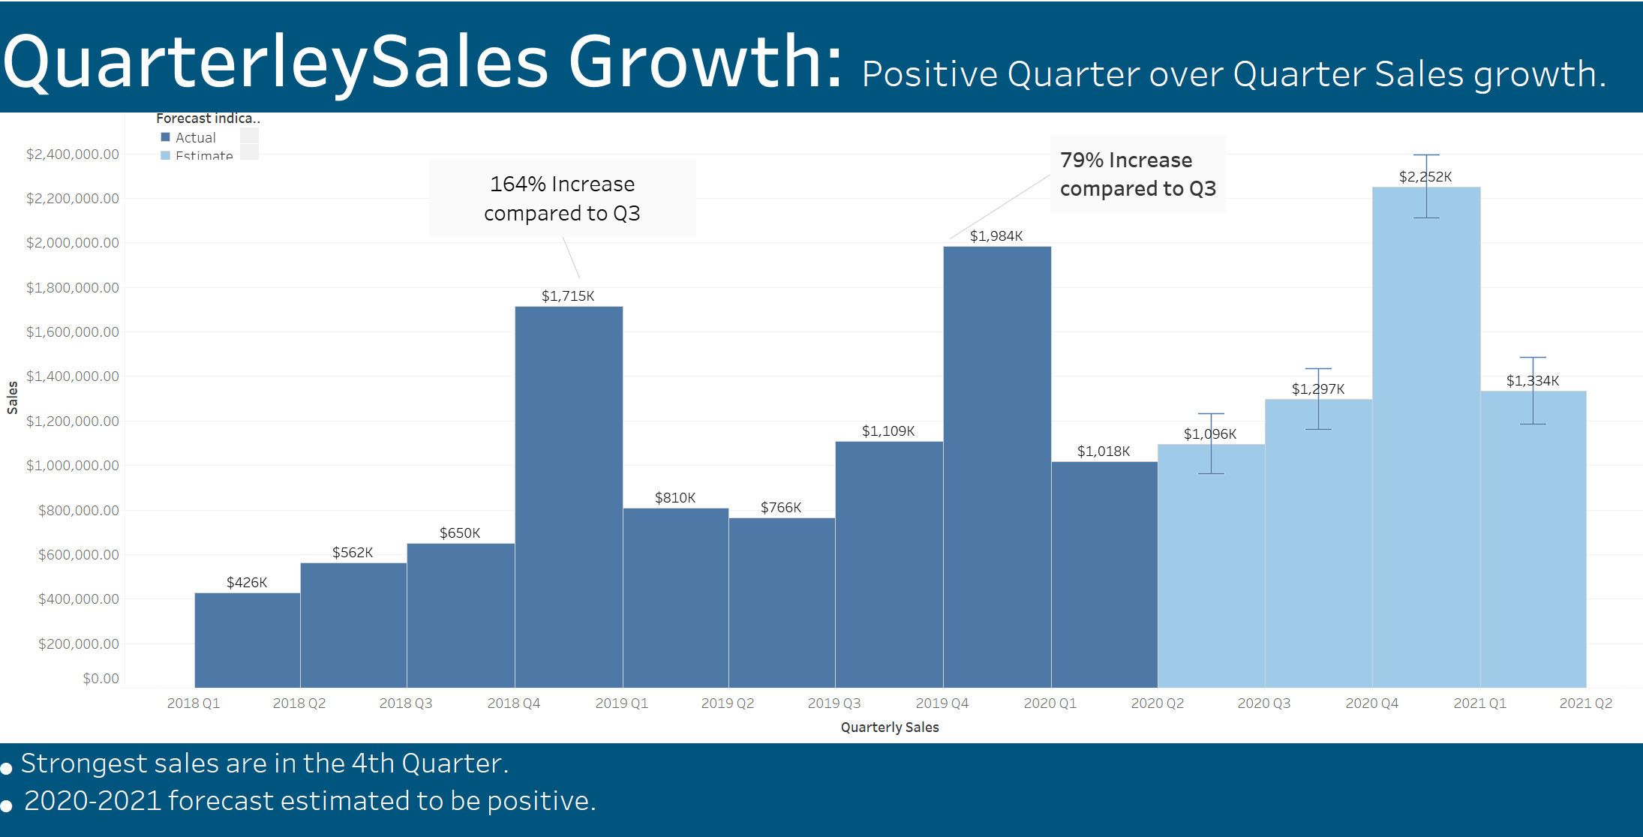

Slide 11
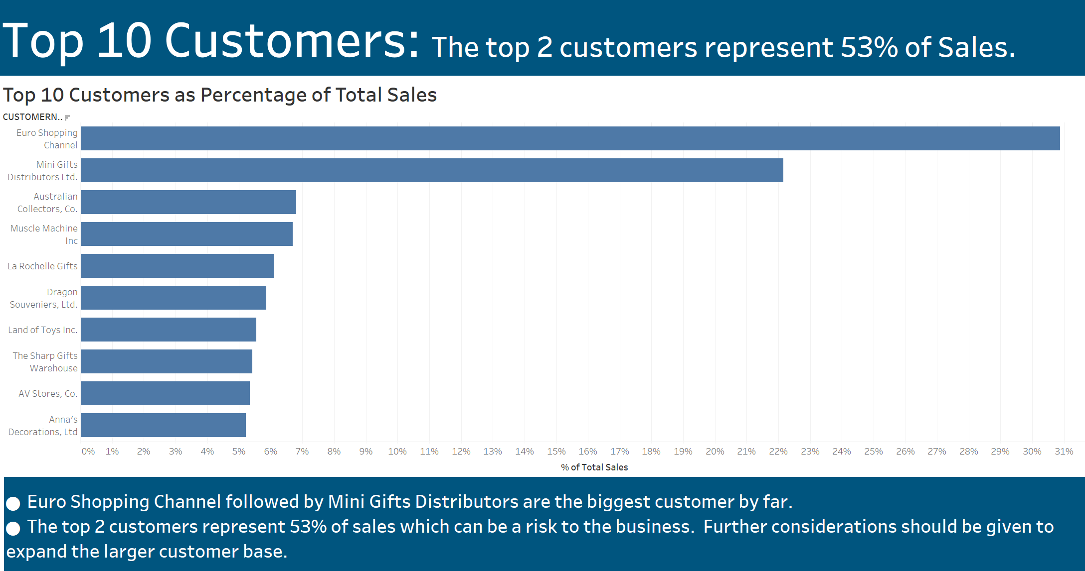

Slide 12
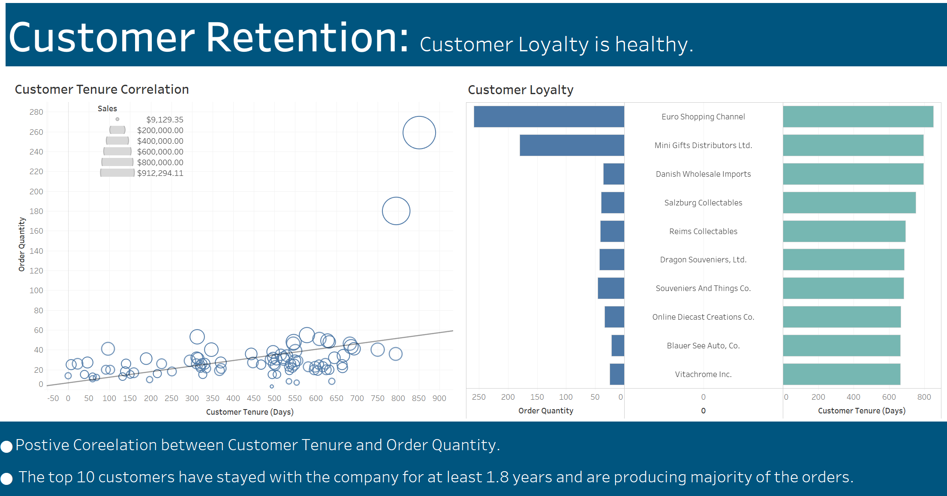

Slide 13
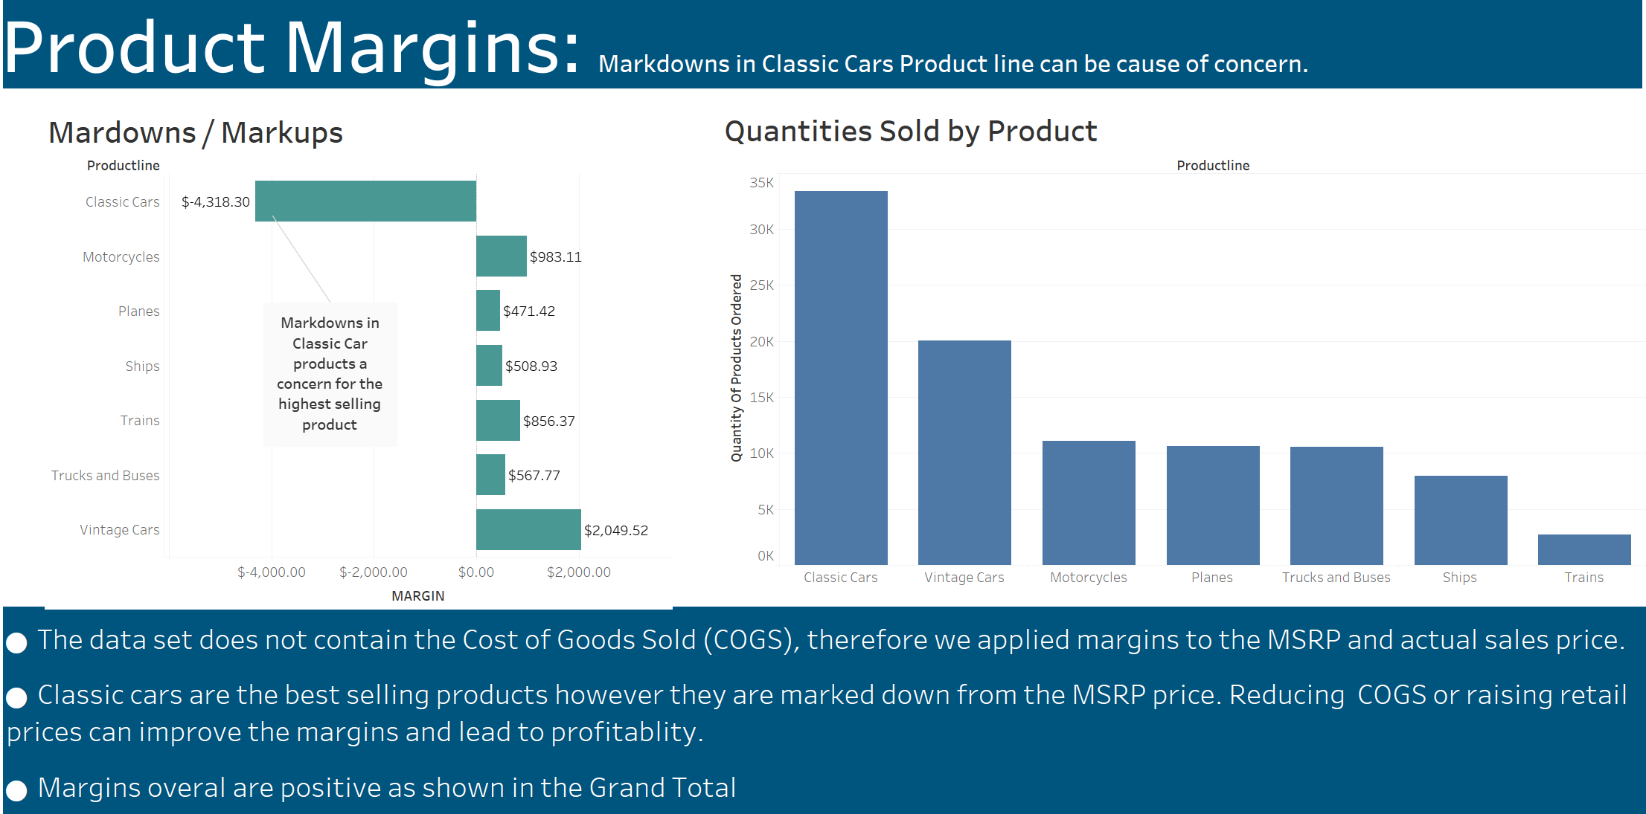

Slide 14
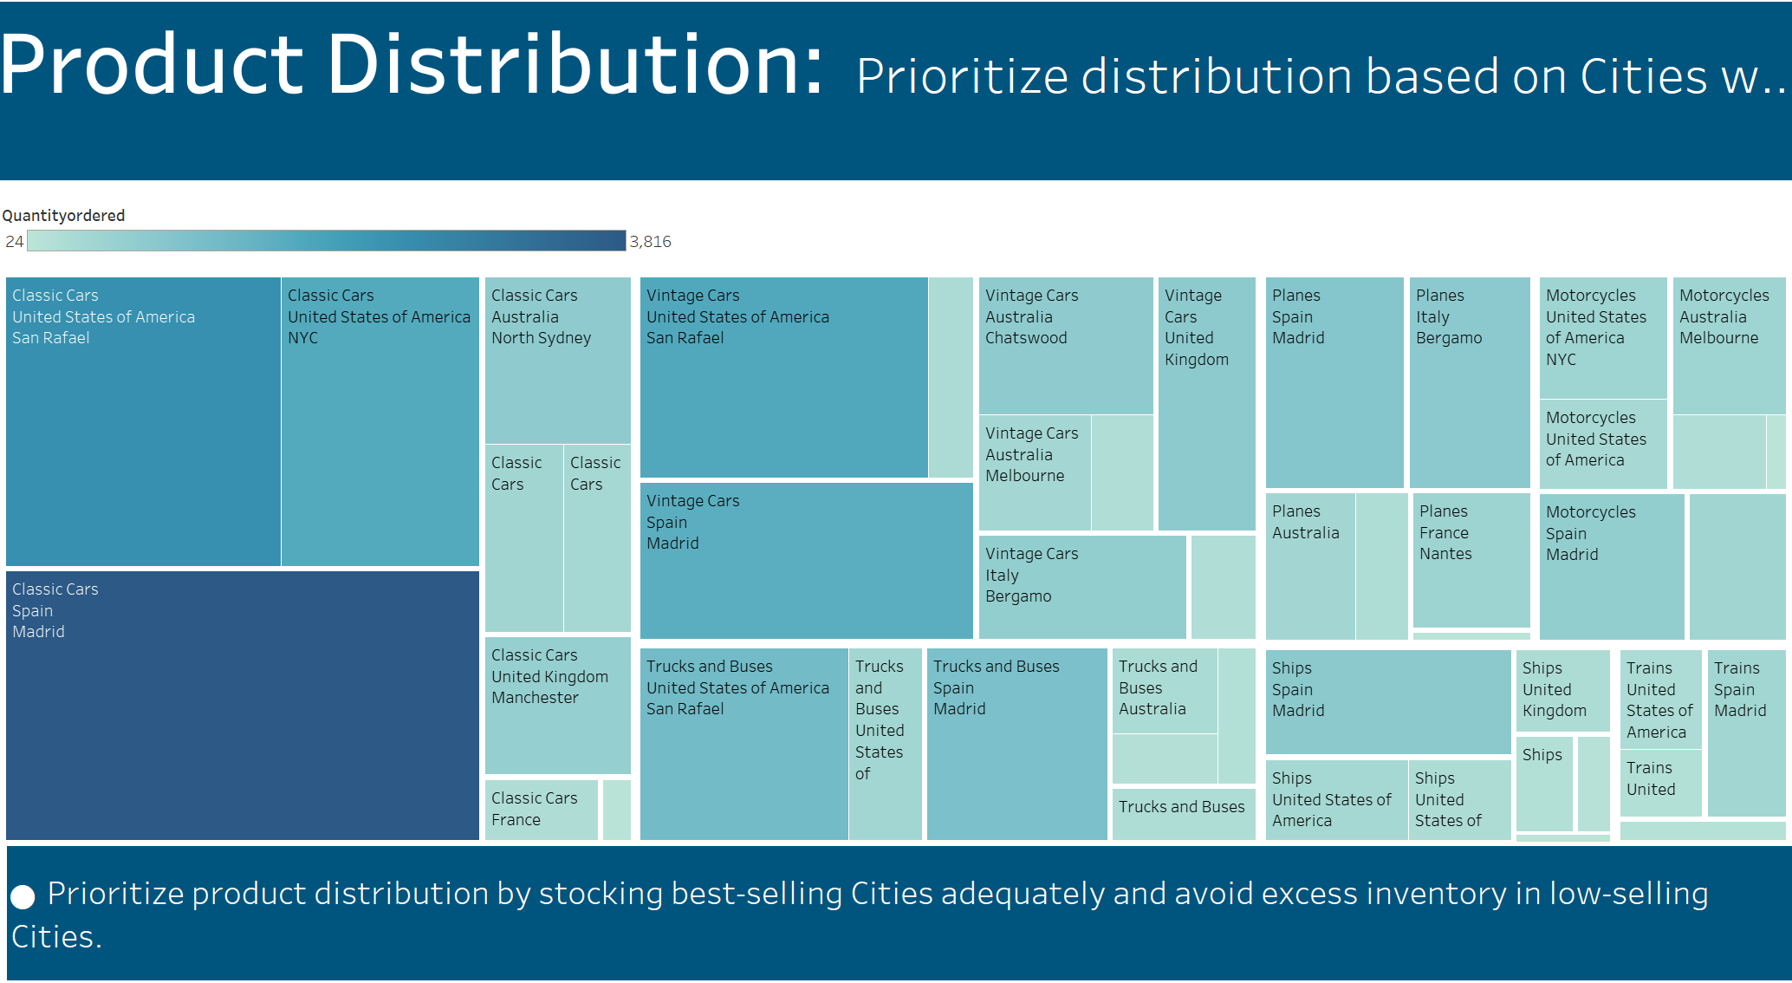

Slide 15
Recommendations
The Auto Toy Sales Company is profitable with strong sale trends as evident in Q/Q sales growth and steady customer loyalty. 2019 produced $4.7M in sales and there is no reason to believe that 2020 could not have been even better if we had complete data as shown by our forecast model. Margins remain healthy overall for 6 out of 7 products but one was a cause for concern.
The following recommendations should help to further boost profitability and growth:
Address Classic Car Markdowns which is our highest selling product. Some examples include reducing manufacturing cost and increasing the selling price.
Capitalize on the seasonality as November and December are the strongest selling Months.
More efficient product distribution based on the Cities with the highest demand.
Expansion into new countries and markets.

Slide 16

Influenza Season Assisting a medical staffing agency in preparing for influenza season by analyzing trends to proactivity plan staffing needs nationwide.

Slide 17
Influenza
Skills
Data cleaning, integration and transformation
Data Profiling and Integrity
Statistical hypothesis
Testing
Tableau/Visual analysis
Forecasting
Data
Challenges
Data format - Excel CSV.
Regions: North America.
Pivot Tables and Charts.
Population Data - US Census Bureau
Influenza Deaths - By CDC
Influenza Visits Data Set - By CDC
Influenza Lab Test Data Set - By CDC
Survey of Flu Shots in Children - By CDC
Data cleaning, missing data, format issues and standardizing the dataset.
Possible notice omitted info as raw data has 8% not stated and 81% as suppressed, thus info was limited to elderly, even though vulnerable group involves wider category of people.

Slide 18
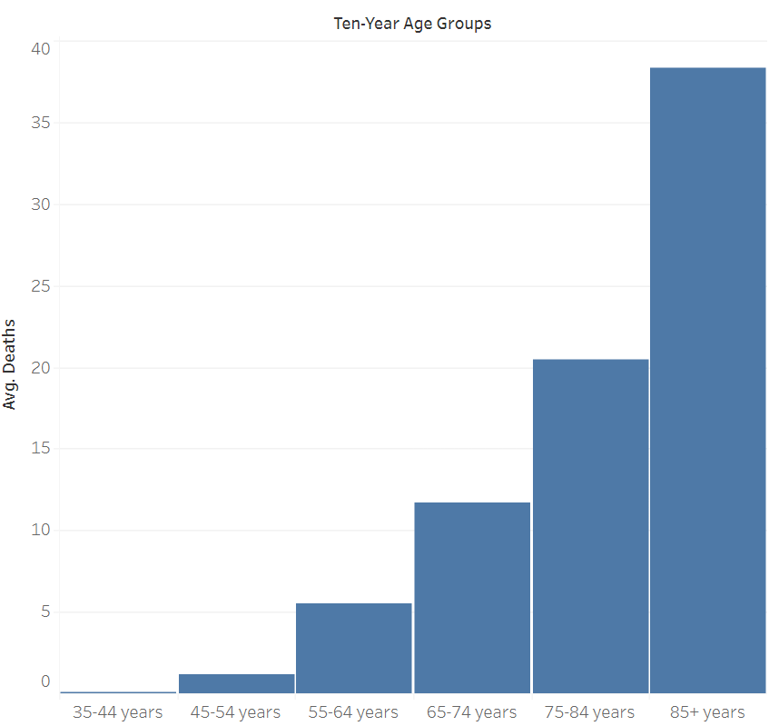
Influenza Mortality Rate by Age-Group
The impact from Influenza significantly increases with age.

Slide 19
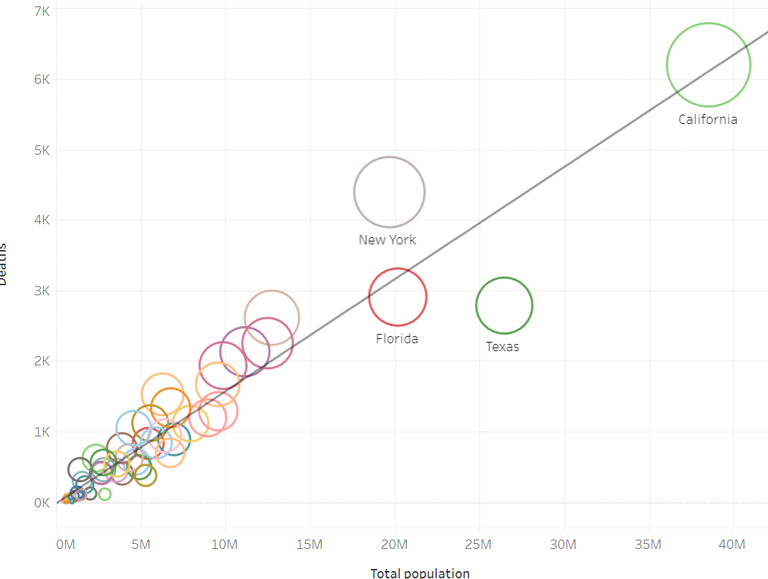
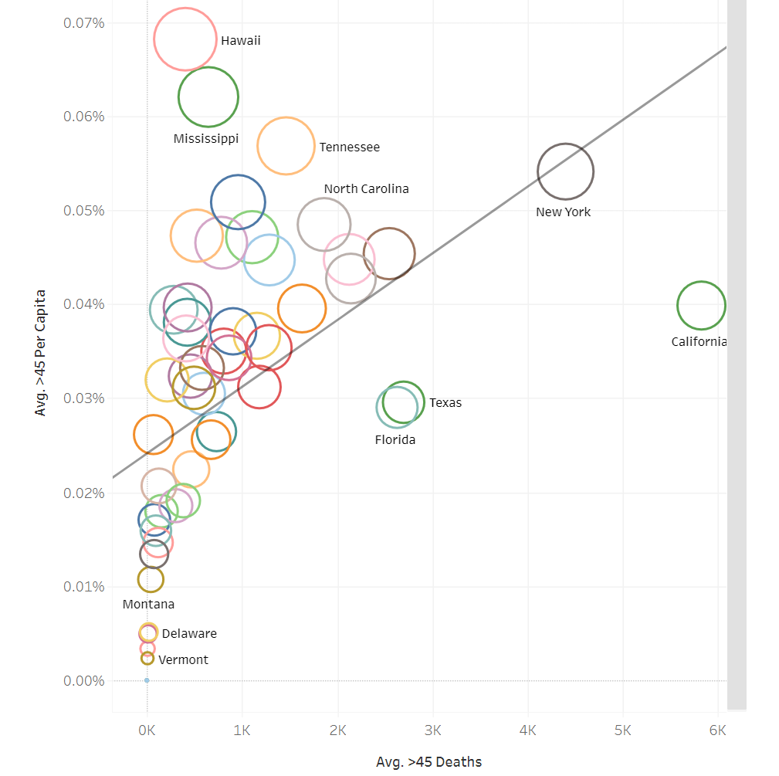
Insights
Influenza Death vs. State Population
Per Capita Influenza Deaths By State
California, New York, Florida & Texas were amongst the highest death rate.
When viewing States on a per capita death rate, Hawaii & Mississippi rank amongst the highest.

Slide 20
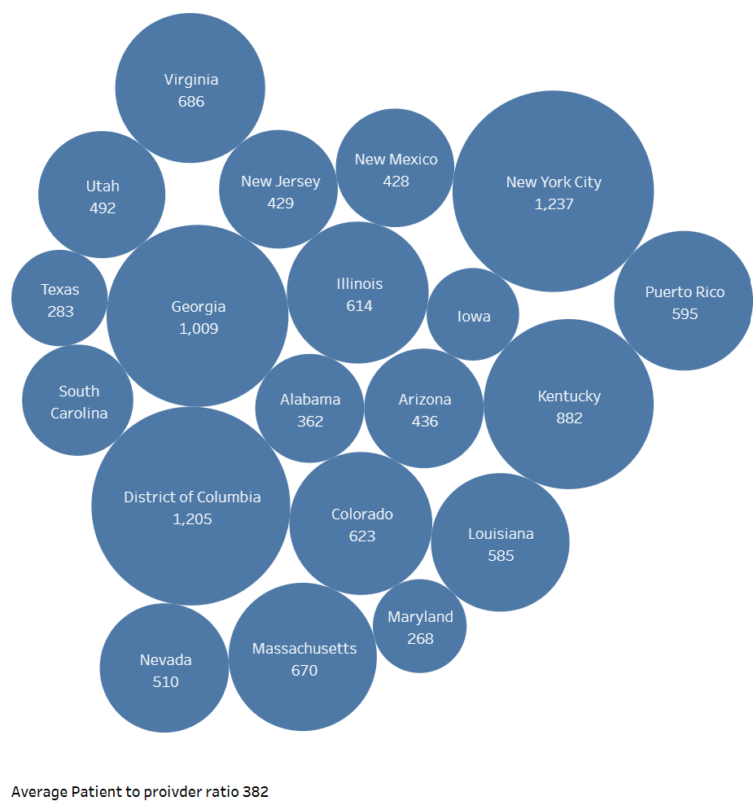
Insights
Patient To Provider Rations
Higher patient to provider ratios in States can result in inadequate medical attention for patients.

Slide 21
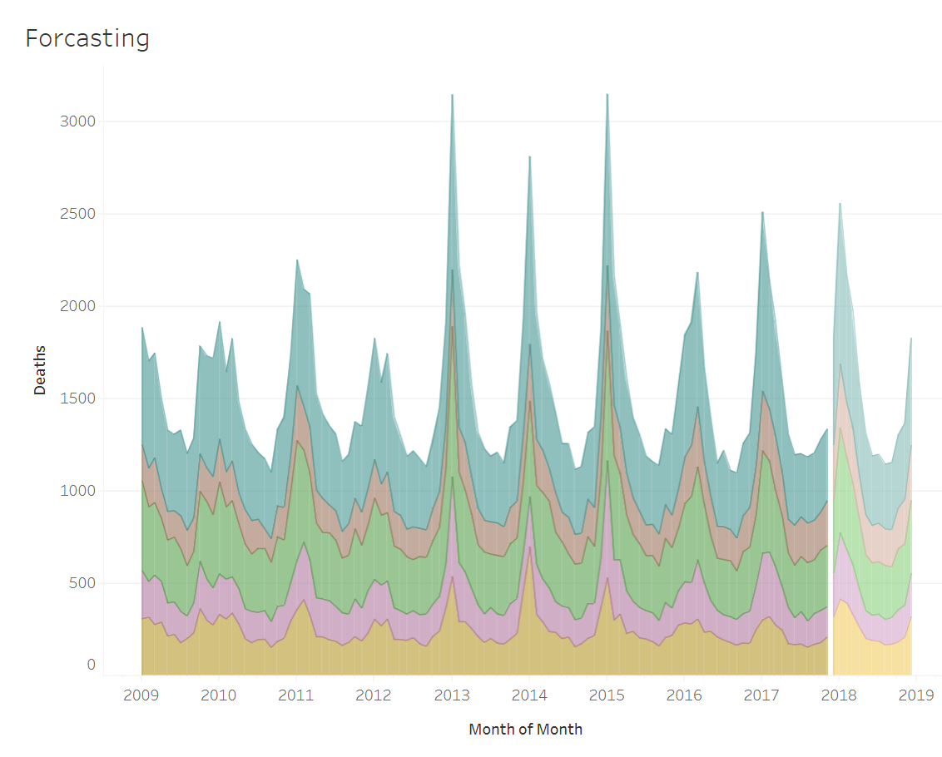
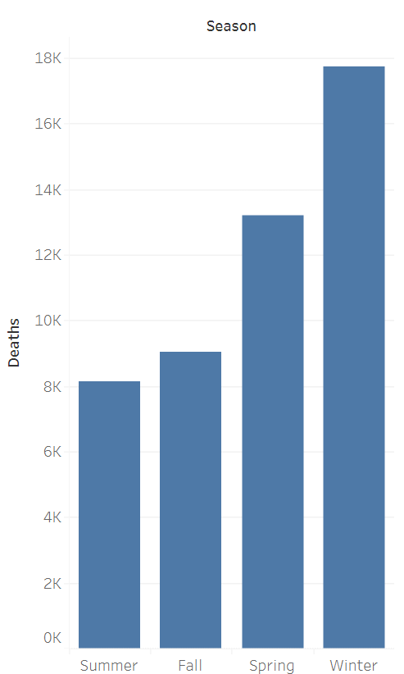

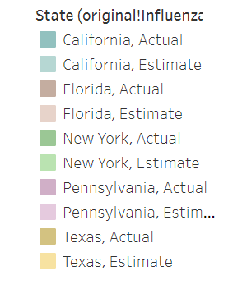
Insights
Forecasting Top 10 States: Influenza Deaths
Death Rate Count By Season
The trend continues into 2018.
Winter has the highest death rates since cold weather affects our bodies.

Slide 22
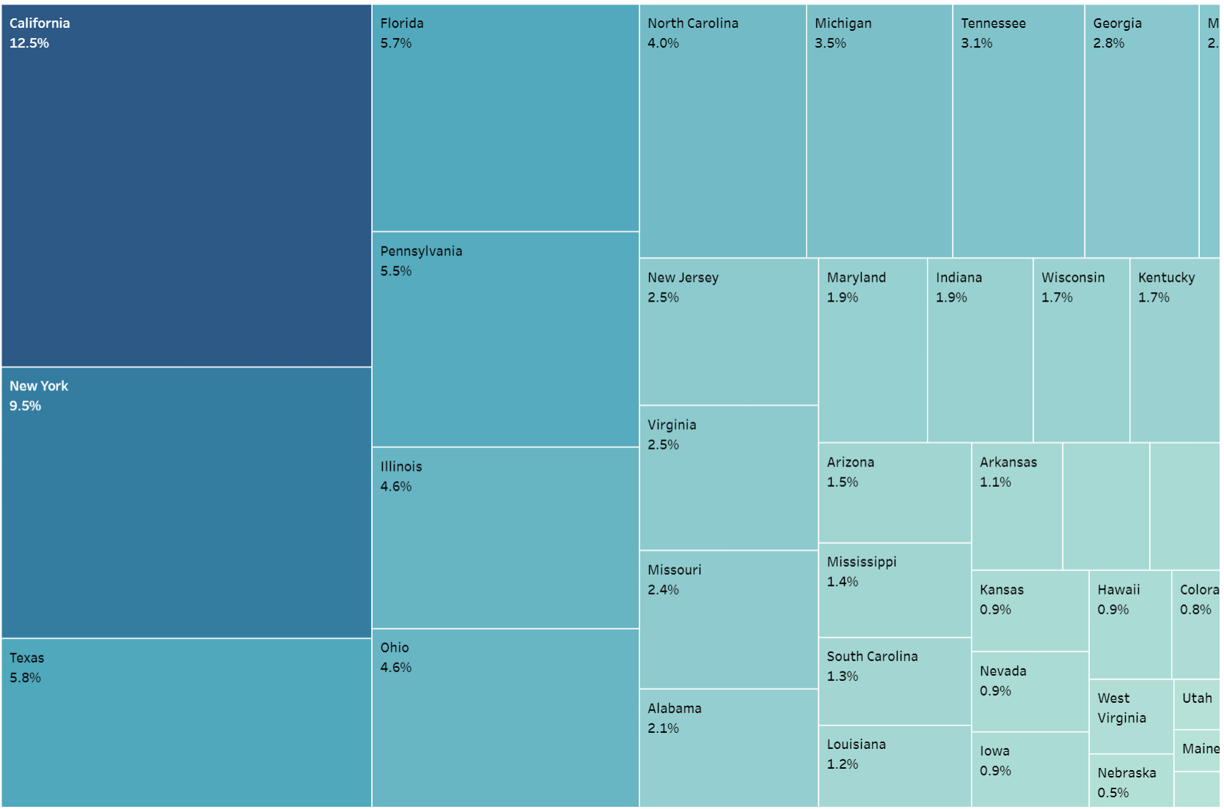
Mortality Rate by State Deployment of medical staff prioritized based on States with highest mortality rate.

Slide 23
Recommendations
Influenzas ranks within top 10 for the highest mortality rate and particularly increases with age. Efficient deployment of medical staff & resources can help to flatten the curve and improve patients care. I recommend several proactive measures:
Deploy medical resources to States based prioritized by Influenzas Death Rate outlined in the tree map.
Increase flu shots in States with higher per capita death rate during the CDC recommended months of September and October.
Improve patient care by increasing the number of providers to States with a higher patient-to-provider ratio

Slide 24

GameCo Analyzing global video game sales to help understand how GameCo’s new games might fare in the market.

Slide 25
GameCo
Skills
Data Cleaning
Data Grouping and Summarizing
Descriptive Analysis
Pivot Table
Visualization Charts in Excel/PowerPoint
Data
Challenges
16.5K titles.
Data format - Excel CSV.
Regions: North America, Europe, Japan and others.
Information: title, platforms, year, genre, publisher.
Pivot Tables and Charts.
Data Source: VGChartz
Data cleaning, missing data, format issues and standardizing the dataset.
Lack of recent data.
Decrease of Sales do not reflect the real numbers due to lack of recent data.

Slide 26
History of Video Game Sales
Atari was the first gaming platform and started in 1980
In the Mid-90s Video Games started to ramp up with the advent of the Sony PlayStation
Since the mid 90s, the three Biggest Platform Makers are Sony PlayStation, Microsoft XBox, and Nintendo
Video Game Unit Sales by Platform & Year
Global Unit Sales
Year

Slide 27
Game Sales by Genre
Global Unit Sales by Genre
Global Unit Sales Breakdown
Top three biggest Genres in terms of global unit sales: Action, Sports and Shooter.

Slide 28
Video Game Sales By Genre
Break Down By Genre
Percent Breakdown Unit Sales
The Sony PlayStation leads in the Top three biggest Genres in terms of global unit sales which are Action, Sports and Shooter.

Slide 29
Number Of Publishers - Top Three Platforms
Yearly Count of Gaming Publishers by Top 3 Platform Makers
Number of Publishers
Year
Sony has the most publishers making games for its platforms

Slide 30
Sales Comparison By Platform– Top Three
Five Year Regional Sales Trend by Platform
Sum of Global Sales
Sony is the dominant platform as compared to Microsoft and Nintendo
2016 has the least sales across the three platforms.
Sony European sales have been trending upward and have surpassed North American sales with the exception of 2016.
Microsoft & Nintendo sales have been trending downwards
Japan sales are mostly Nintendo and Sony although sales for both have been trending downward.

Slide 31
Summary
Sony has the most publishers making games for its Platforms.
Nintendo is losing market share rapidly.
Although Sales have been on decline across the three major Gaming Platforms since 2008, Sony is the dominant Gaming Platform leading in Sales globally.
Historically North America has been the largest sales region for Sony however, its European sales have surpassed North American sales in the last several years.
Action, Sports and Shooter are the top three genres and Sony leads in these categories.
Sony should continue to focus on European Sales and look into why North American sales are slowly in decline.
Further investments in the top three genres (Action, Shooter & Sports) may improve sales.

Slide 32
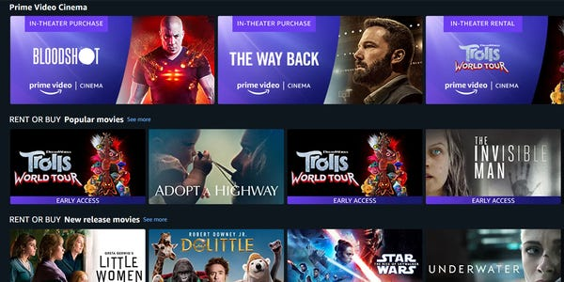
Rockbusters Analyze Rockbuster’s data through SQL queries for the launch strategy of the new online video service.

Slide 33
Rockbuster
Launch Strategy Analysis
SQL
Database querying
Filtering
Cleaning and summarizing
Joining tables
Subqueries
Common table expressions
Data
Challenges
Data format - SQL.
Regions: International.
Develop a relational database.
Schema
Performing subqueries
Data Source: Project Brief
Data cleaning, missing data, format issues and standardizing the dataset.
Does not provide info related to historical data or that would allow a market trend analysis or forecast.

Slide 34
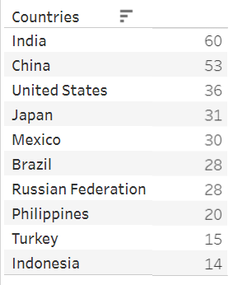
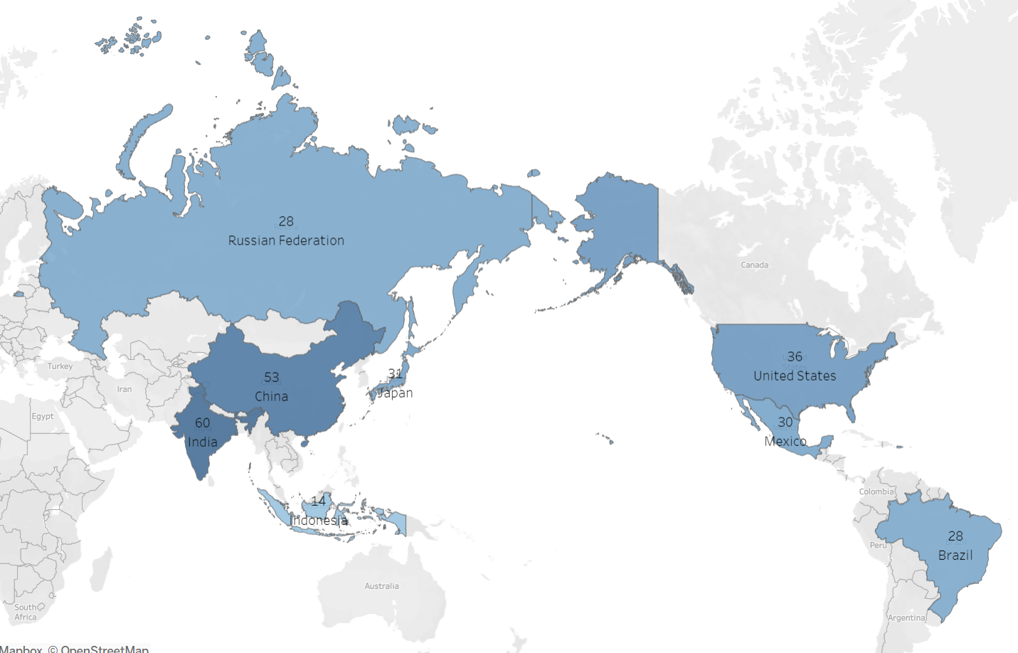
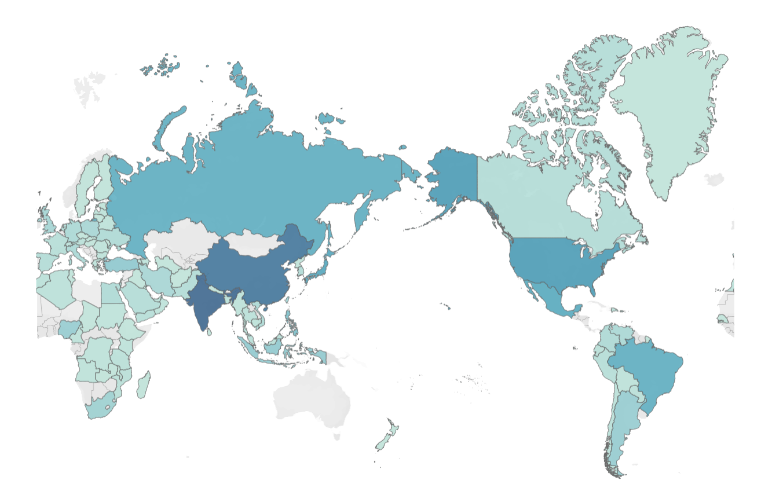
Customer Count For The Top 10 Countries
Rockbuster customers are spread around the world in 108 distinct countries. These are the top 10 countries in terms of number of customers.

Slide 35
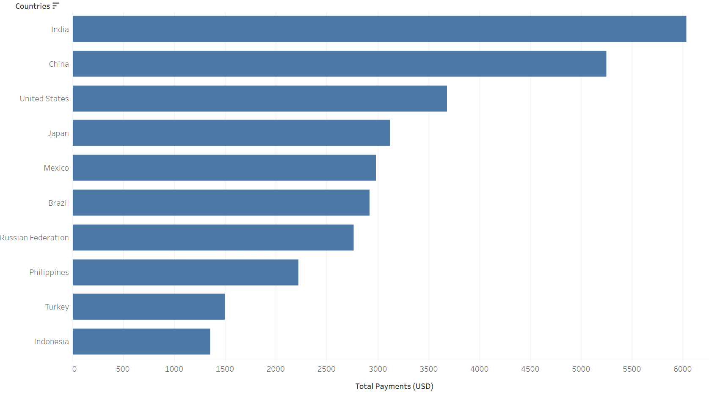
Top Ten Countries With The Highest Total Payments
10 countries have revenue greater than $1,000. The top 10 countries in terms of customers are the same top 10 countries with higher revenue.

Slide 36
Recommendations
Strategic promotion and engagement: Offer targeted discounts on highest-grossing movies year-round. Especially key markets like India, China, USA to attract new audiences and foster loyalty. Introduce personalized discounts on online accounts sign ups to enhance customer retention.
Focus on high quality content: Prioritize top performing movies and discontinue underperforming one to streamline the content library. Ensure consistent focus on quality title that resonate with diverse customer bases.

Slide 37

Instacart Basket Derive insights and suggest strategies for increasing sales based on exploratory analysis

Slide 38
Instacart Basket
Skills
Python Libraries – Pandas & Numpy
Visualization with Python – Seaborn, Matplotlib & Scipy
Jupyter Notebook
Data wrangling and merging
Deriving variables
Grouping & Aggregating data
Data
Challenges
Data format - Excel
Python Libraries - Pandas and Numpy
Data Wrangling and Subsetting
Data Consistency Check
Combining and Exporting Dataframe
Customer Data set – By CareerFoundry
Instacart Data Set – Via Kaggle
Data cleaning, missing data, format issues and standardizing the dataset.
The data has time limitation, since comprise information from 2017 only. The customer data provided by CareerFoundry was fabricated and used for the solo proposes of study.

Slide 39
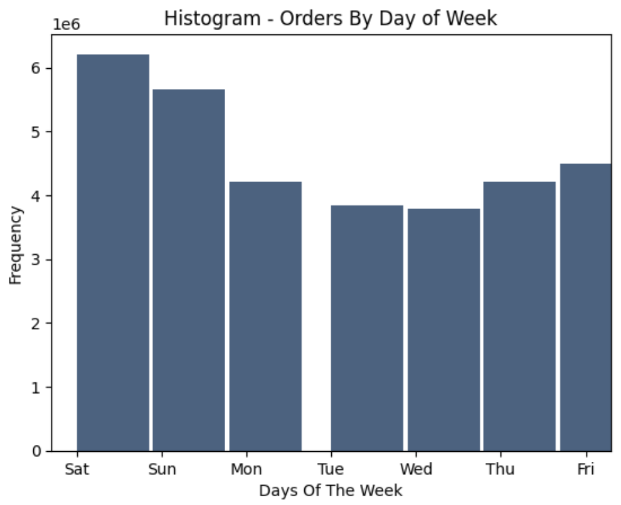
Busiest Days
Mon
How busy each day of the week according to number to number of orders.. Saturdays and Sundays are busiest days and Tuesdays and Wednesdays are the least busy days.

Slide 40
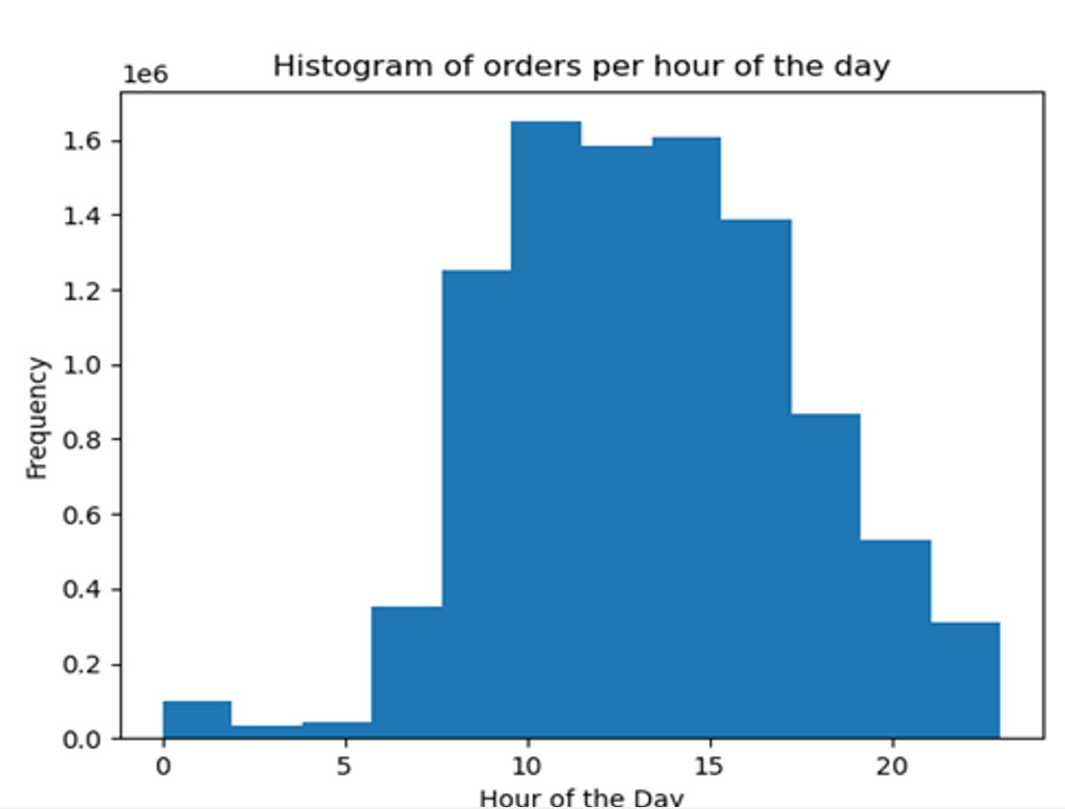
Busiest Hours
The busiest hours, increase at 9 am until 3pm, when it starts to decrease.

Slide 41
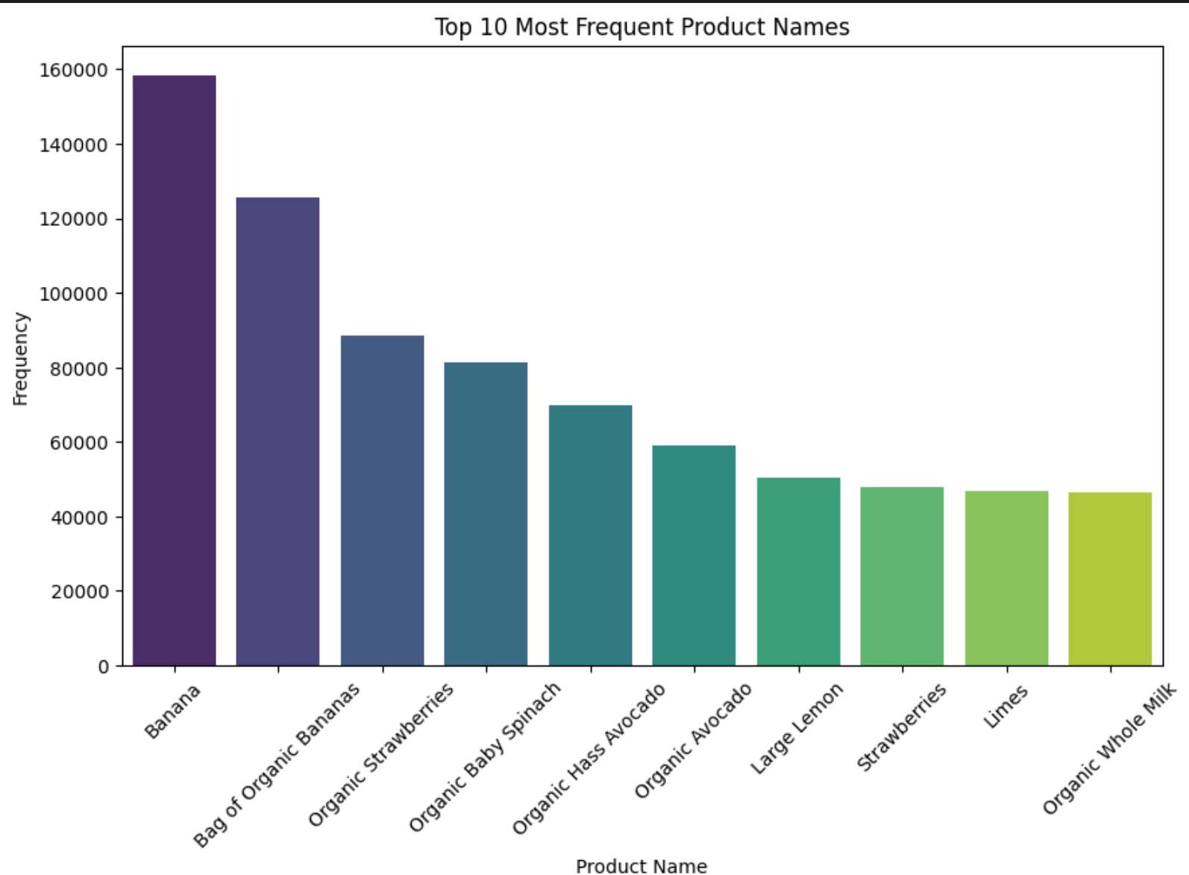
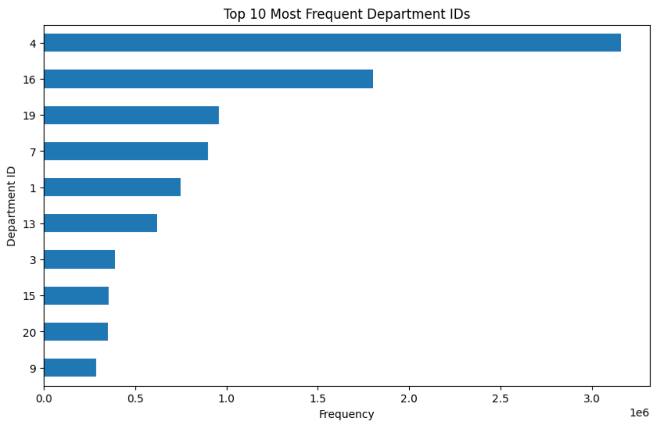
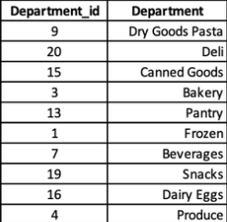
Top 10 Products and Departments
Data Dictionary
Top 10 Departments consumed by all regions in the Instacart database. Produce is the highest, which could indicate a buying trend by its customers. Within Produce, Bananas are the top purchased Produce.
.

Slide 42
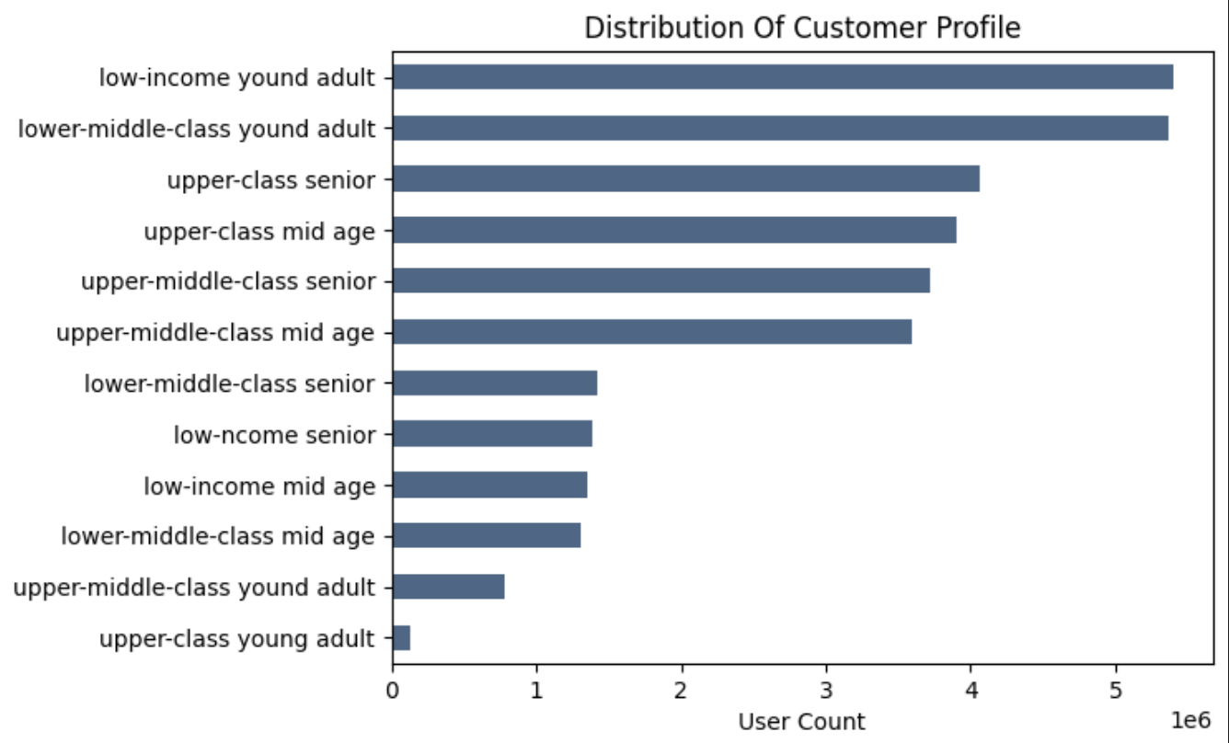
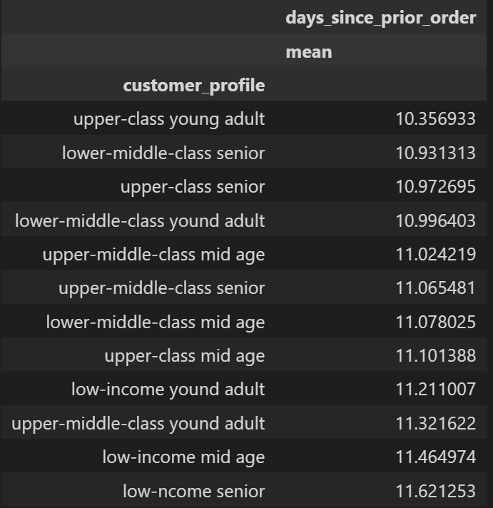
Customer Profile
Low-income young adults come more often than other demographics, however, they do not return as often as others. This is an opportunity to provide incentives, so they come more often and spend more.
.

Slide 43

Market Analysis
Expenditure By Hour Of Day
Hour Of Day
According to the graph above customers have a higher tendency to spend more between 4 am to 8 am, as well as from 8 pm until 10 pm. This can be an opportunity to sell more expensive products.
.

Slide 44
Recommendations
Runs all ads from Monday to Thursday when they are fewer sales to try and boost the sales on these days as well.
Run the ads in morning for more expensive products
Give more discounts on the most popular products types (snacks, pantry, and personal care)
Give more discounts to loyal costumers, so they come back more often and buy more stuff.

Slide 45

Pig E. Bank Analytical support to the anti-money laundering compliance department to assess client and transactional risk at a global bank.

Slide 46
Pig E. Bank
Skills
Intro to Big Data
Data Ethics:
Bias Security and Privacy
Data Mining
Predictive Analysis
Time Series Analysis and Forecasting
Decision Tree
Data
Challenges
Data format - Excel
Time Series analysis forecasting
Intro to Data Mining
Data Ethics: Bias, Security and Privacy
Data Source: Customer Data Set- By CareerFoundry
Data cleaning, missing data, format issues and standardizing the dataset.
Data does not provide date, so it’s impossible to observe whether there was a trend of customer loss during specific period or something that occurred instantly

Slide 47
Insights
Few contributing factors on why clients are leaving the bank can be analyzed by:
Age
Gender
Balance
Tenure
Credit Card

Slide 48

Decision tree based on gender, country & age.
Females had a higher number of exits as compared to men.
Within the female population, middle aged females were higher.
Germany saw the most exits as compared to Spain and France

Slide 49
Recommendations
Pig E Bank should conduct surveys with their customers regularly, This will help to better understand customers banking needs.
Provide incentives for females particular the one’s who are up in age.
Offer competitive rates for German customers.
Since less active customers are more likely to leave, active customers should benefit in some way.

Slide 50
Let’s Connect!
Robert Indelicato Data Analyst

